Slide 1


Introduction to jupyter notebooks part 2

Slide 2
What you will learn
Introduction
Setting Up JupyterLab
Basic Features of JupyterLab
Adding Visuals and Interactivity
Sharing and Exporting Notebooks
Best Practices and Tips
Conclusion

Slide 3
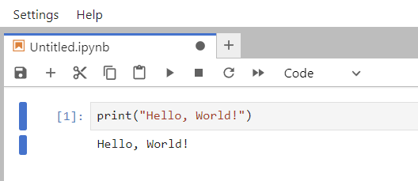
A tale of two cells: code
Notes:
Print(“Hello, World”)

Slide 4
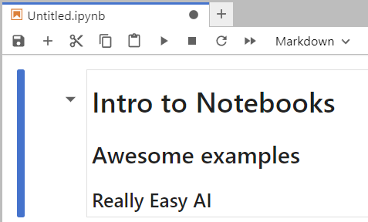
A tale of two cells: markdown
Notes:
# Intro to Notebooks
## Awesome Examples
### Really Easy AI

Slide 5
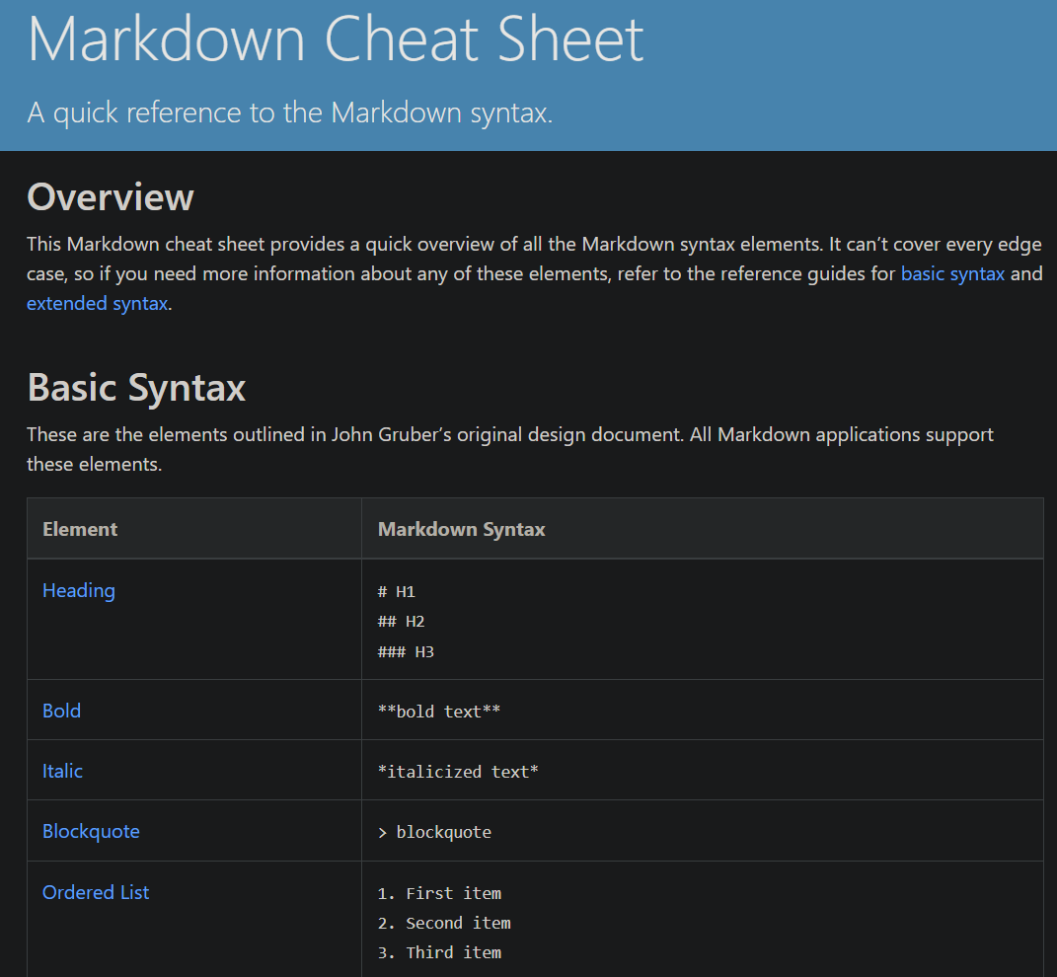
Notes:
https://www.markdownguide.org/cheat-sheet/

Slide 6
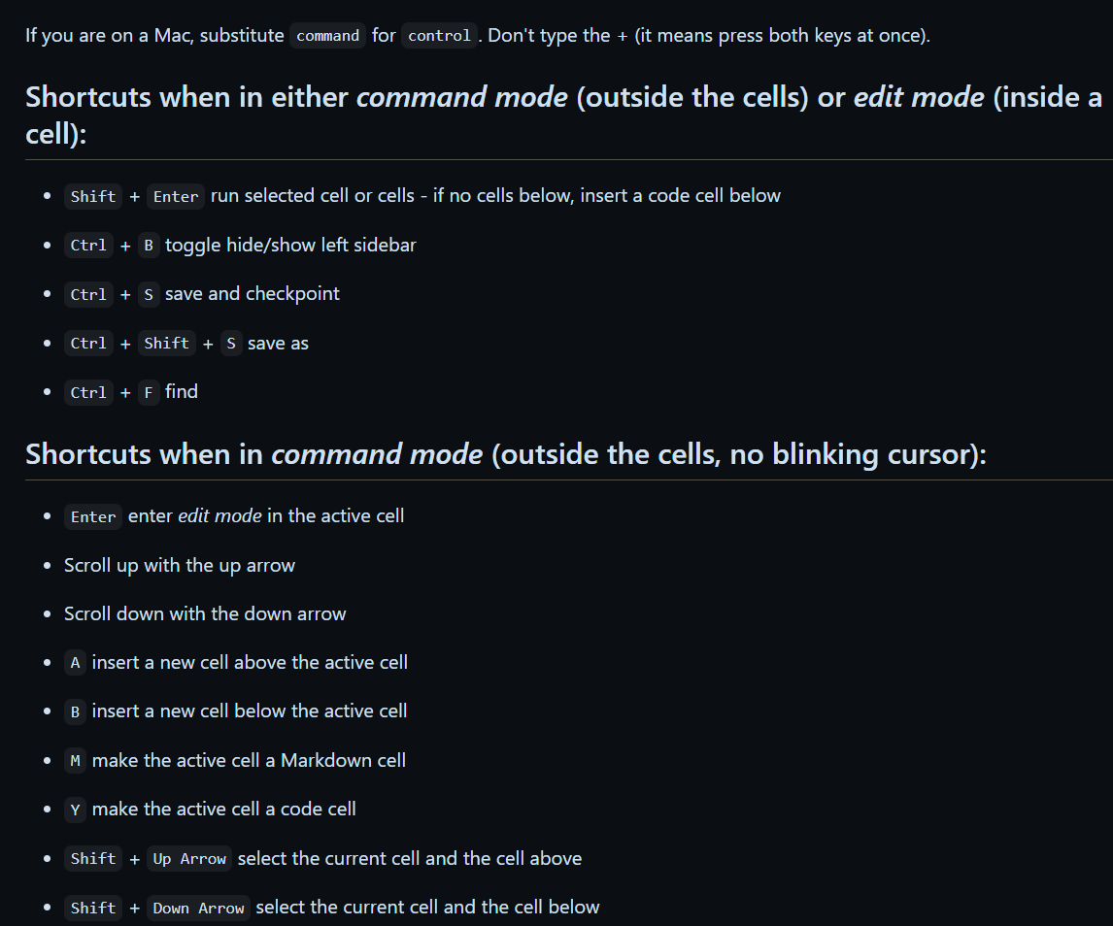
Notes:
https://gist.github.com/discdiver/9e00618756d120a8c9fa344ac1c375ac

Slide 7
Adding visuals & Interactivity

Slide 8
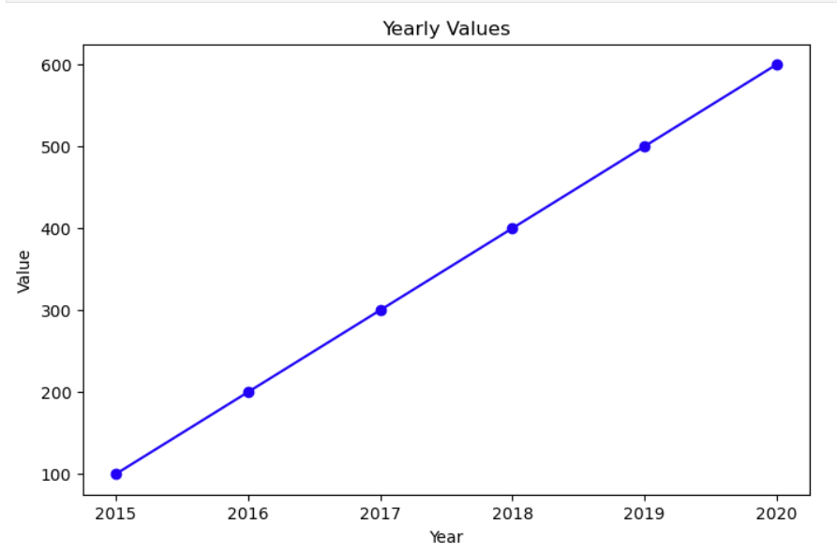
Notes:
import matplotlib.pyplot as plt
# Sample data
years = [2015, 2016, 2017, 2018, 2019, 2020]
values = [100, 200, 300, 400, 500, 600]
# Create a line plot
plt.figure(figsize=(8, 5))
plt.plot(years, values, marker='o', linestyle='-', color='b')
# Adding titles and labels
plt.title('Yearly Values')
plt.xlabel('Year')
plt.ylabel('Value')
# Show the plot
plt.show()

Slide 9
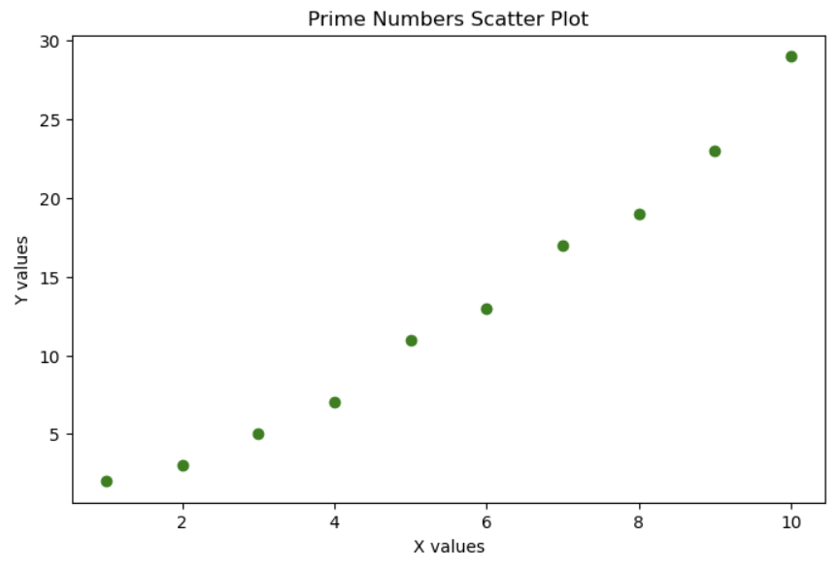
Notes:
import matplotlib.pyplot as plt
# Sample data
x = [1, 2, 3, 4, 5, 6, 7, 8, 9, 10]
y = [2, 3, 5, 7, 11, 13, 17, 19, 23, 29]
# Create a scatter plot
plt.figure(figsize=(8, 5))
plt.scatter(x, y, color='green')
# Adding titles and labels
plt.title('Prime Numbers Scatter Plot')
plt.xlabel('X values')
plt.ylabel('Y values')
# Show the plot
plt.show()

Slide 10
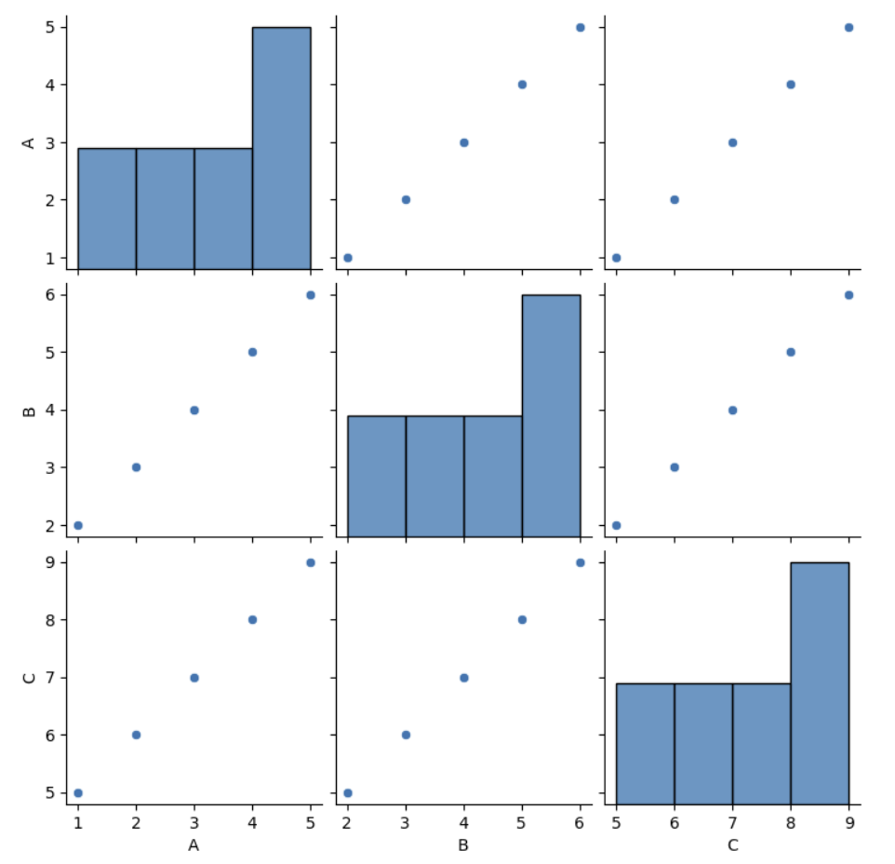
Notes:
import seaborn as sns
import matplotlib.pyplot as plt
import pandas as pd
# Sample data
data = {
'A': [1, 2, 3, 4, 5],
'B': [2, 3, 4, 5, 6],
'C': [5, 6, 7, 8, 9]
}
# Create a DataFrame
df = pd.DataFrame(data)
# Create a pairplot
sns.pairplot(df)
# Show the plot
plt.show()

Slide 11
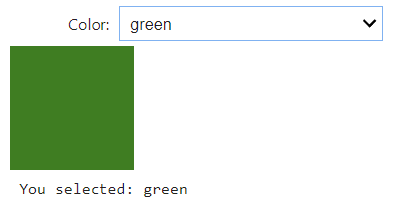
Notes:
! pip install nodejs ipywidgets
import ipywidgets as widgets
from IPython.display import display, HTML
# Create a dropdown widget for color selection
color_dropdown = widgets.Dropdown(
options=['red', 'green', 'blue', 'yellow', 'purple'],
value='red',
description='Color:',
)
# Create an output widget to display the selected color
output = widgets.Output()
# Define a function to update the output when the color is changed
def on_color_change(change):
with output:
output.clear_output()
selected_color = change.new
display(HTML(f'<div style="width: 100px; height: 100px; background-color: {selected_color};"></div>'))
print(f"You selected: {selected_color}")
# Attach the function to the dropdown widget
color_dropdown.observe(on_color_change, names='value')
# Display the widgets
display(color_dropdown, output)

Slide 12
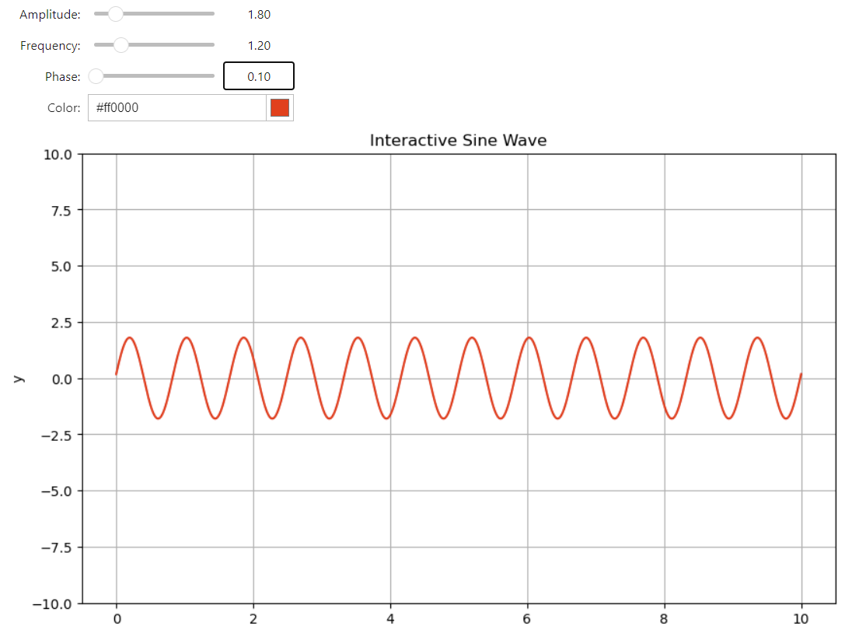
Notes:
import numpy as np
import matplotlib.pyplot as plt
import ipywidgets as widgets
from IPython.display import display
# Function to plot the sine wave
def plot_sine_wave(amplitude, frequency, phase, color):
x = np.linspace(0, 10, 1000)
y = amplitude * np.sin(2 * np.pi * frequency * x + phase)
plt.figure(figsize=(10, 6))
plt.plot(x, y, color=color)
plt.ylim(-10, 10)
plt.title('Interactive Sine Wave')
plt.xlabel('x')
plt.ylabel('y')
plt.grid(True)
plt.show()
# Create widgets
amplitude_slider = widgets.FloatSlider(value=1, min=0, max=10, step=0.1, description='Amplitude:')
frequency_slider = widgets.FloatSlider(value=1, min=0.1, max=5, step=0.1, description='Frequency:')
phase_slider = widgets.FloatSlider(value=0, min=0, max=2*np.pi, step=0.1, description='Phase:')
color_picker = widgets.ColorPicker(value='blue', description='Color:')
# Create the interactive output
output = widgets.interactive_output(plot_sine_wave, {
'amplitude': amplitude_slider,
'frequency': frequency_slider,
'phase': phase_slider,
'color': color_picker
})
# Display the widgets and the output
display(amplitude_slider, frequency_slider, phase_slider, color_picker, output)

Slide 13
Sharing & Exporting Notebooks

Slide 14
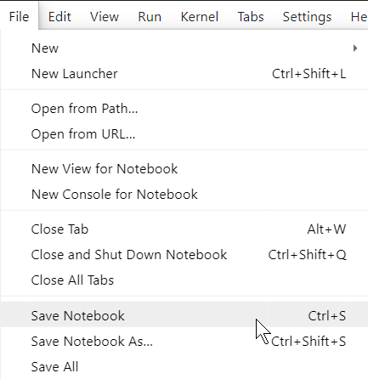
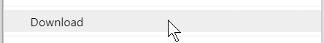
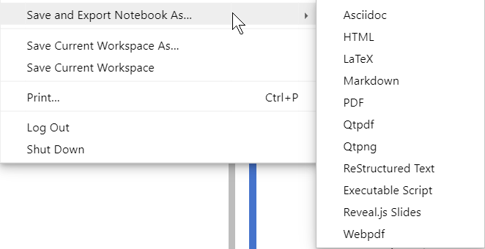

Slide 15
Best Practices & Tips

Slide 16
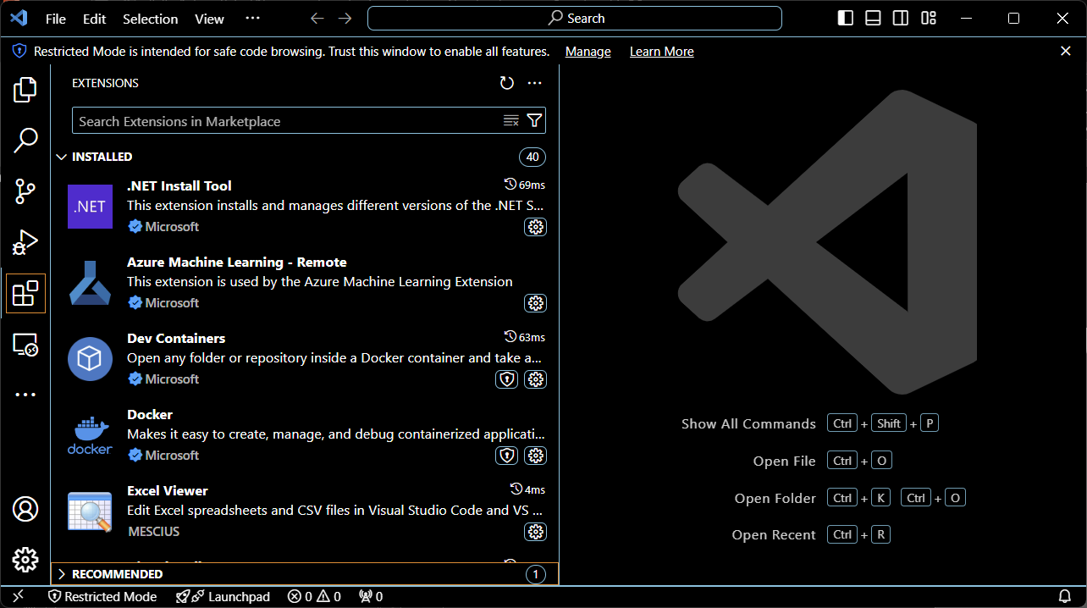
Use VS Code or some other advanced ide

Slide 17
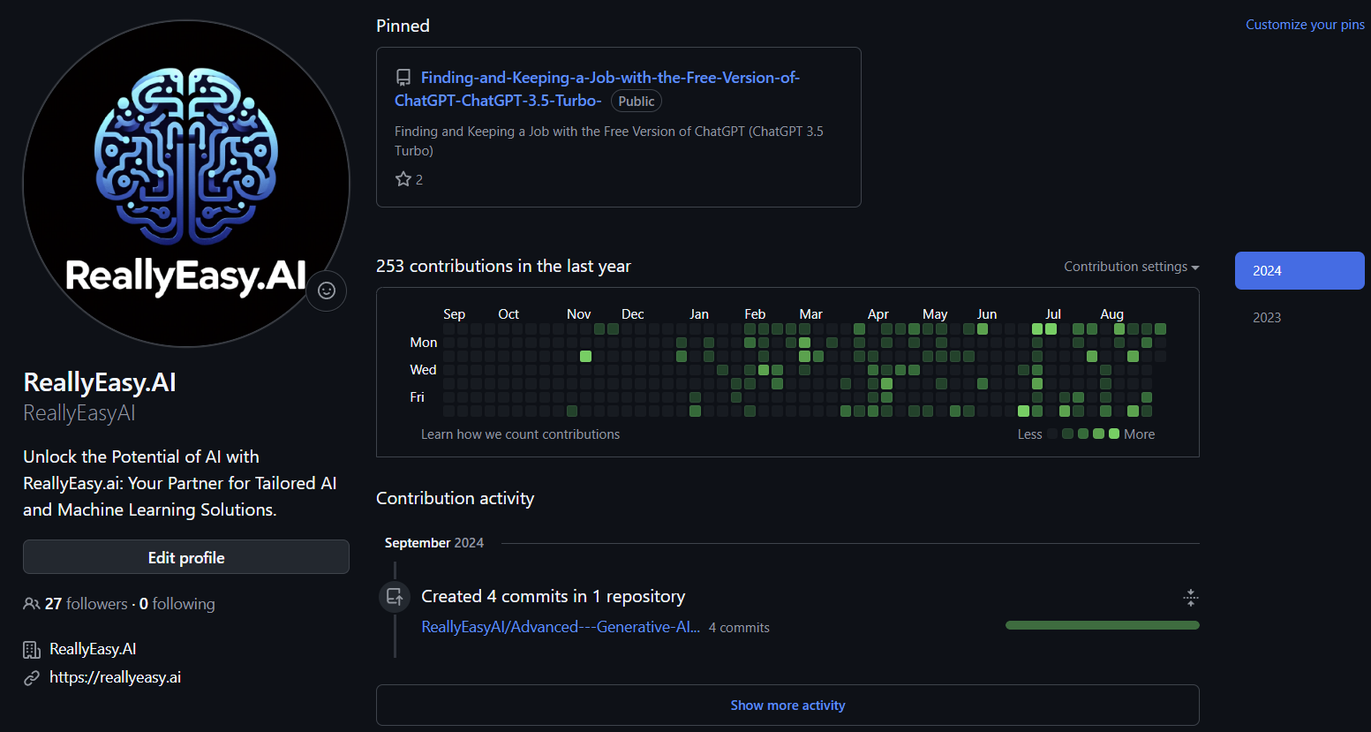
Get a GitHub account & use version control
Notes:
https://github.com/

Slide 18
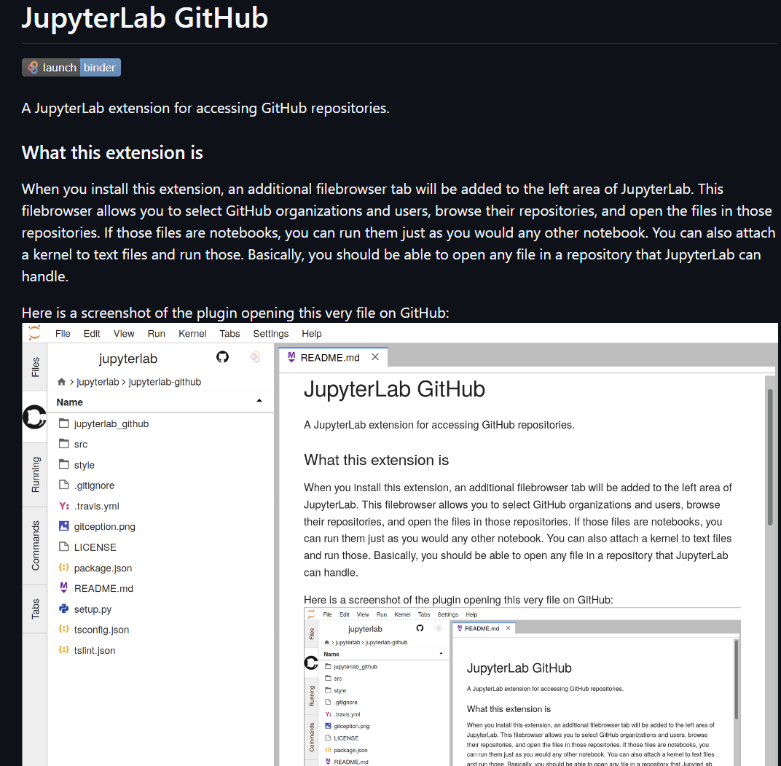
Notes:
https://github.com/jupyterlab/jupyterlab-github

Slide 19
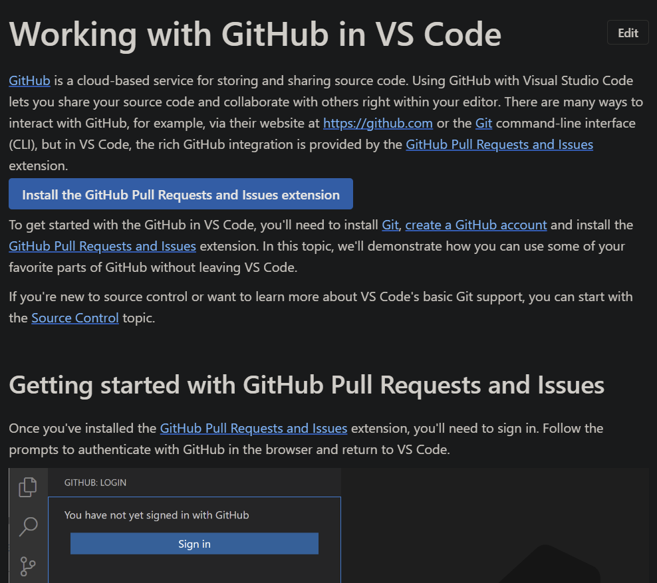
Notes:
https://code.visualstudio.com/docs/sourcecontrol/github

Slide 20


